Slide 1
Calculus
Linear Algebra

Slide 2
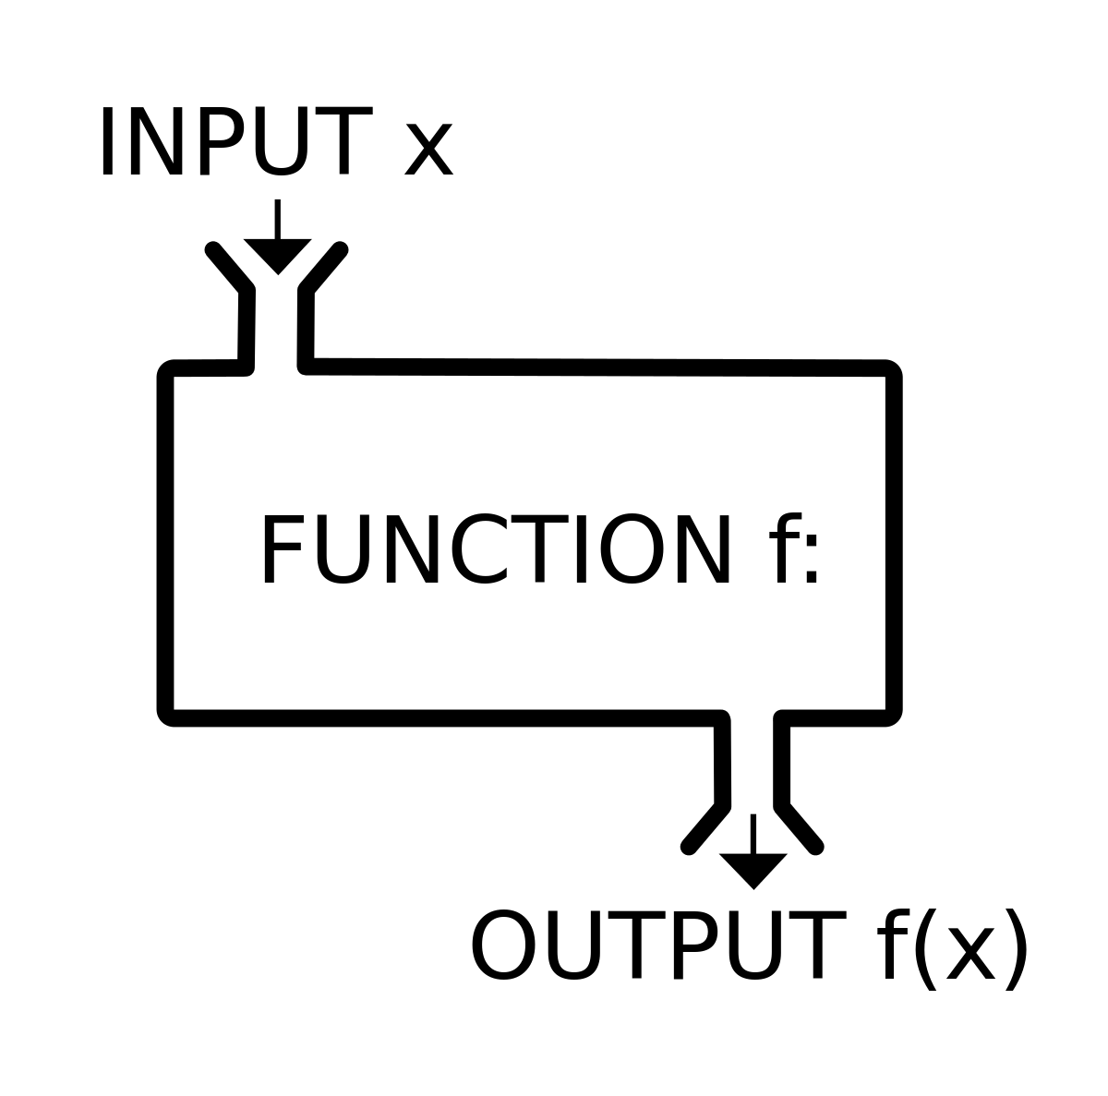
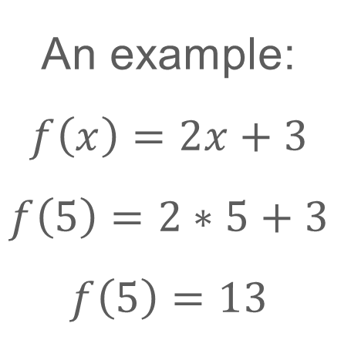
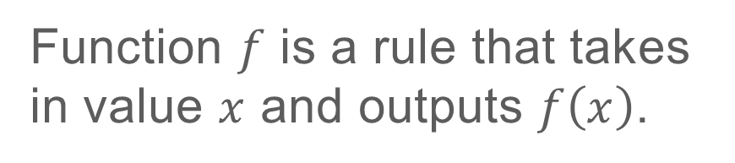
CALCULUS
Function $f$ is a rule that takes in value $x$ and outputs $f\left(x\right)$.
An example:
$$f\left(x\right)=2x+3$$
$$f\left(5\right)=2∗5+3$$
$$f\left(5\right)=13$$
Image Source: https://en.wikipedia.org/wiki/Function_(mathematics)

Slide 3
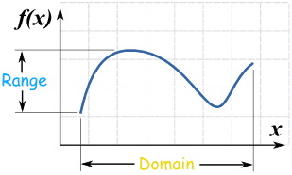
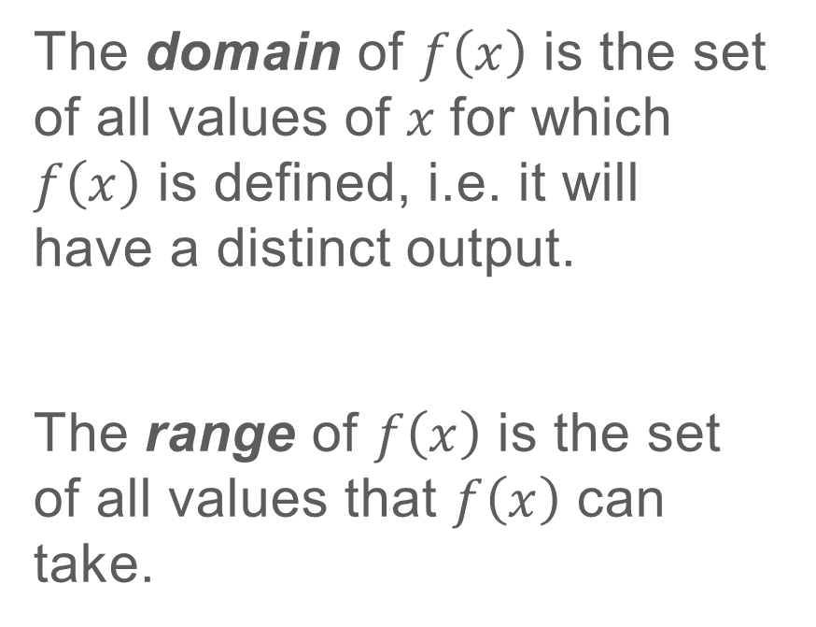
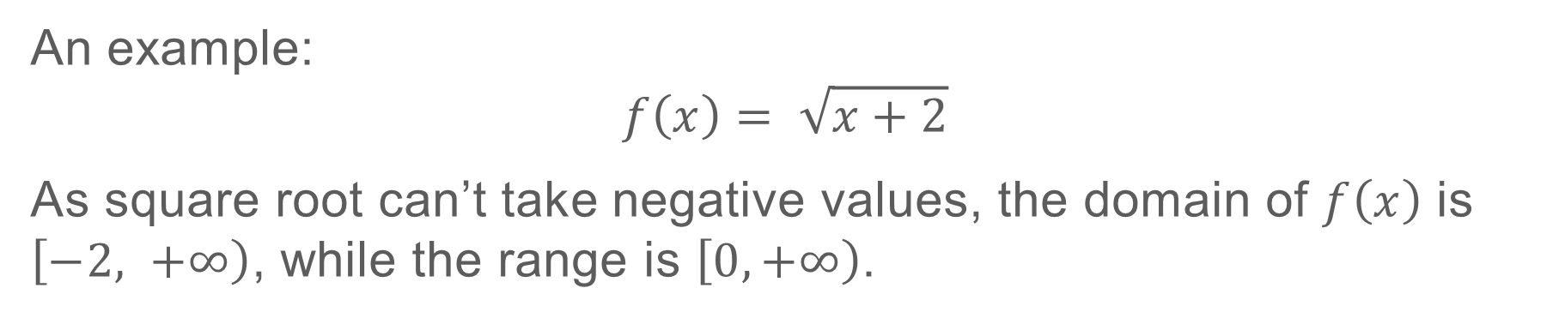
CALCULUS
The domain of $f\left(x\right)$ is the set of all values of $x$for which $f\left(x\right)$ is defined, i.e. it will have a distinct output.
The range of $f\left(x\right)$ is the set of all values that $f\left(x\right)$ can take.
An example:
$$f\left(x\right)= \sqrt{x+2}$$
As square root can’t take negative values, the domain of $f\left(x\right)$ is $\left[−2, \left.+∞\right)\right.$, while the range is $\left[0, \left.+∞\right)\right.$.
Image Source: https://www.mathsisfun.com/sets/domain-range-codomain.html

Slide 4
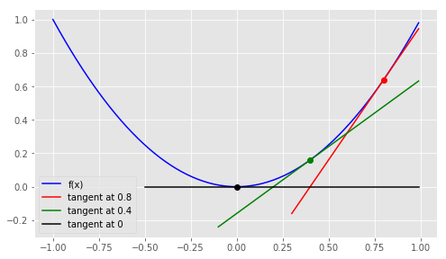
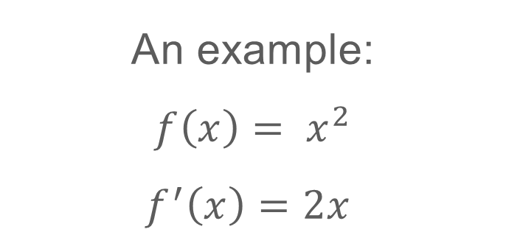
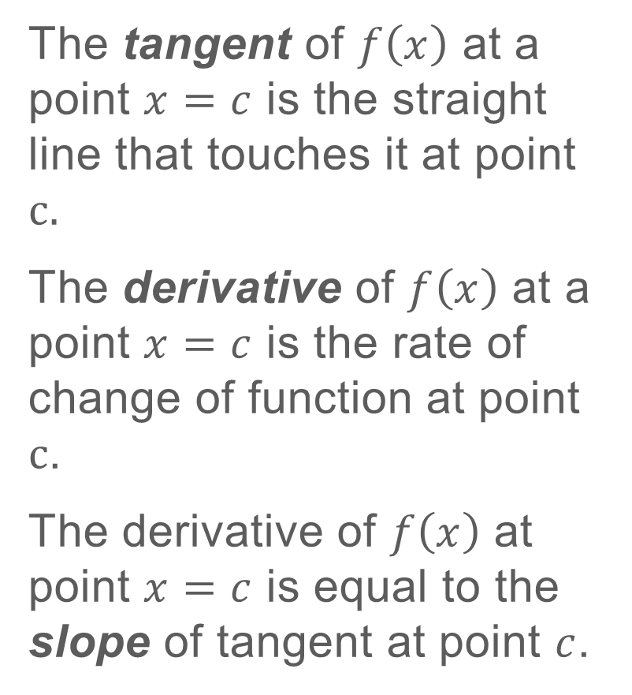
CALCULUS
The tangent of $f\left(x\right)$ at a point $x=c$ is the straight line that touches it at point $c.$
The derivative of $f\left(x\right)$ at a point $x=c$ is the rate of change of function at point $c$.
The derivative of $f\left(x\right)$ at point $x=c$ is equal to the slope of tangent at point $c$.
An example:
$$f\left(x\right)= x^{2}$$
$$f^{′}\left(x\right)=2x$$
Differentiation rules
https://www.mathsisfun.com/calculus/derivatives-rules.html
Implicit Differentiation
https://www.cliffsnotes.com/study-guides/calculus/calculus/the-derivative/implicit-differentiation

Slide 5
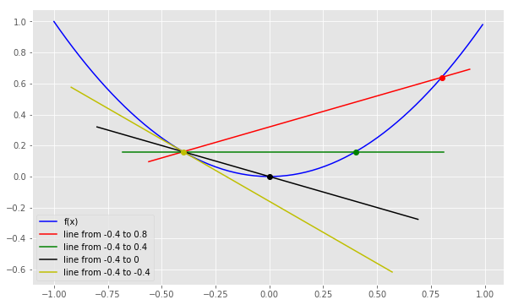
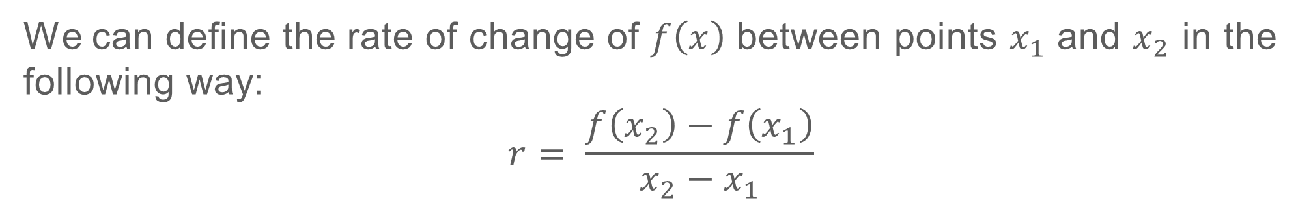
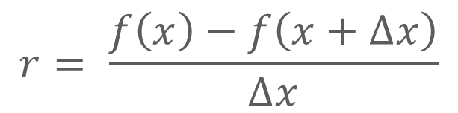
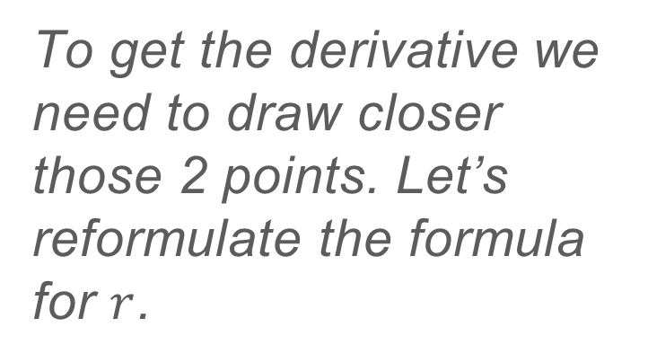
CALCULUS
We can define the rate of change of $f\left(x\right)$ between points $x_{1}$ and $x_{2}$ in the following way:
$$r= \frac{f\left(x_{2}\right)−f\left(x_{1}\right)}{x_{2}−x_{1}}$$
To get the derivative we need to draw closer those 2 points. Let’s reformulate the formula for $r$.
$$r= \frac{f\left(x\right)−f\left(x+∆x\right)}{∆x}$$

Slide 6
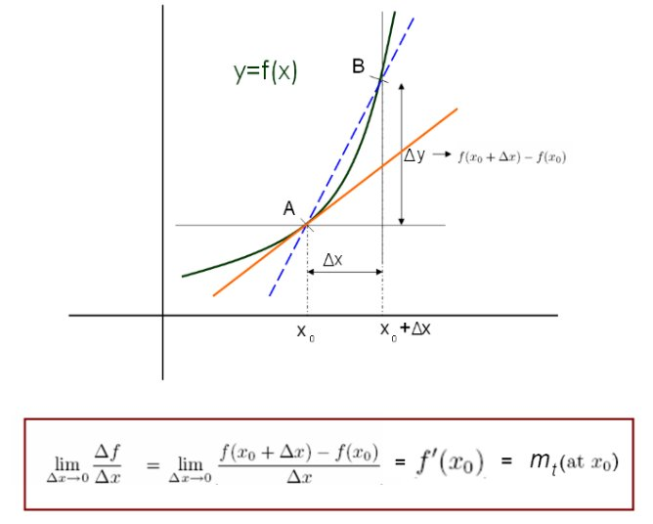
CALCULUS
Image source: http://durofy.com/differential-calculus-the-first-principle

Slide 7
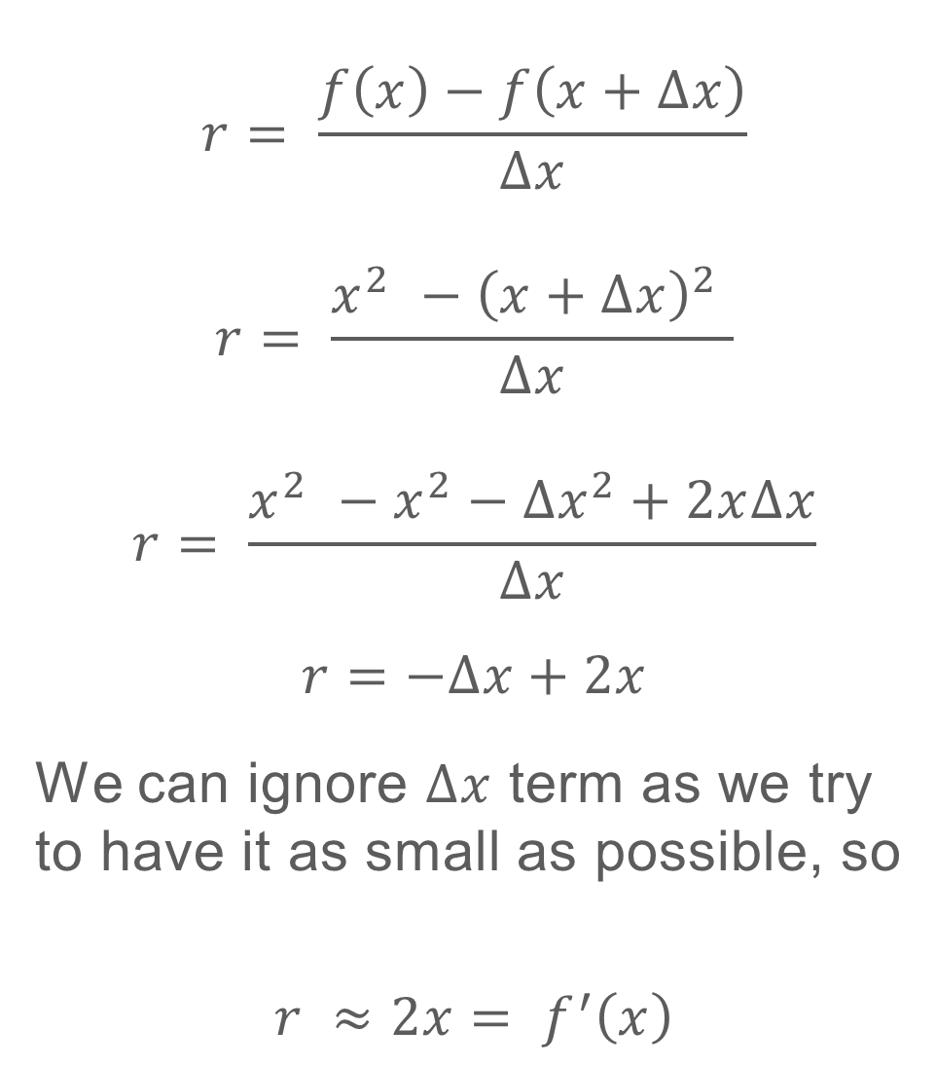
CALCULUS
Now let’s calculate the derivative for $f\left(x\right)= x^{2}$.
$$r= \frac{f\left(x\right)−f\left(x+∆x\right)}{∆x}$$
$$r= \frac{x^{2} −{\left(x+∆x\right)}^{2} }{∆x}$$
$$r= \frac{x^{2} −x^{2}−{∆x}^{2}+2x∆x}{∆x}$$
$$r=−∆x+2x$$
We can ignore $∆x$ term as we try to have it as small as possible, so
$$r ≈2x= f^{′}\left(x\right)$$

Slide 8
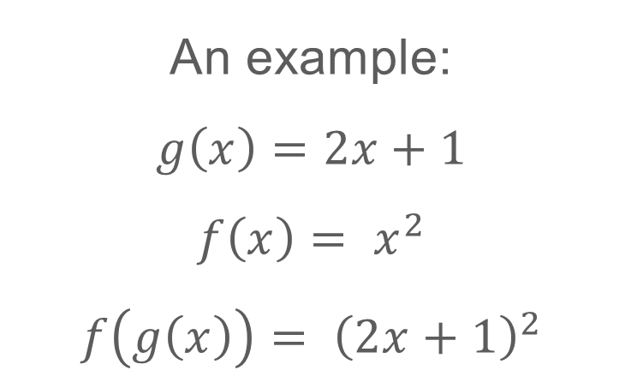

CALCULUS
Function is called a composite function if it is a function of a function:
$$f\left(g\left(x\right)\right)$$
An example:
$$g\left(x\right)=2x+1$$
$$f\left(x\right)= x^{2}$$
$$f\left(g\left(x\right)\right)= {\left(2x+1\right)}^{2}$$

Slide 9
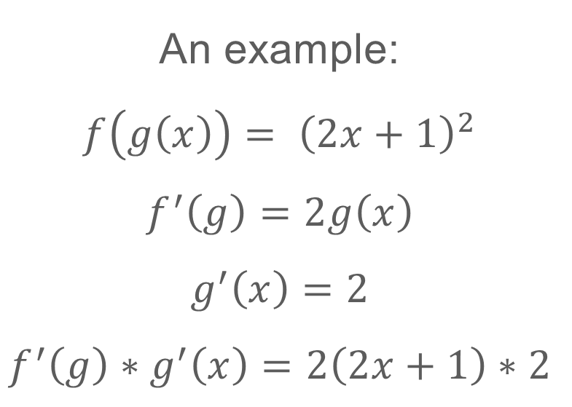
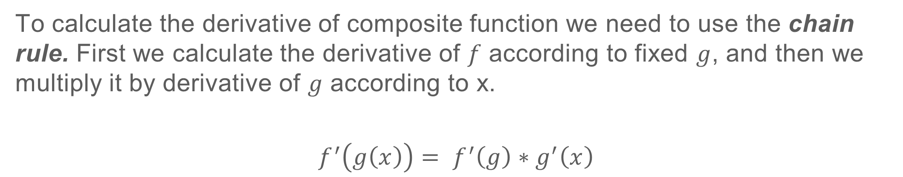
CALCULUS
To calculate the derivative of composite function we need to use the chain rule. First we calculate the derivative of $f$ according to fixed $g$, and then we multiply it by derivative of $g$ according to x.
$$f^{′}\left(g\left(x\right)\right)= f^{′}\left(g\right)∗g^{′}\left(x\right)$$
An example:
$$f\left(g\left(x\right)\right)= {\left(2x+1\right)}^{2}$$
$$f^{′}\left(g\right)=2g\left(x\right)$$
$$g^{′}\left(x\right)=2$$
$$f^{′}\left(g\right)∗g^{′}\left(x\right)=2\left(2x+1\right)∗2$$

Slide 10
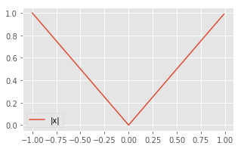
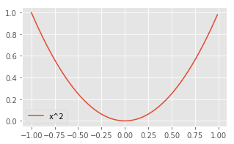
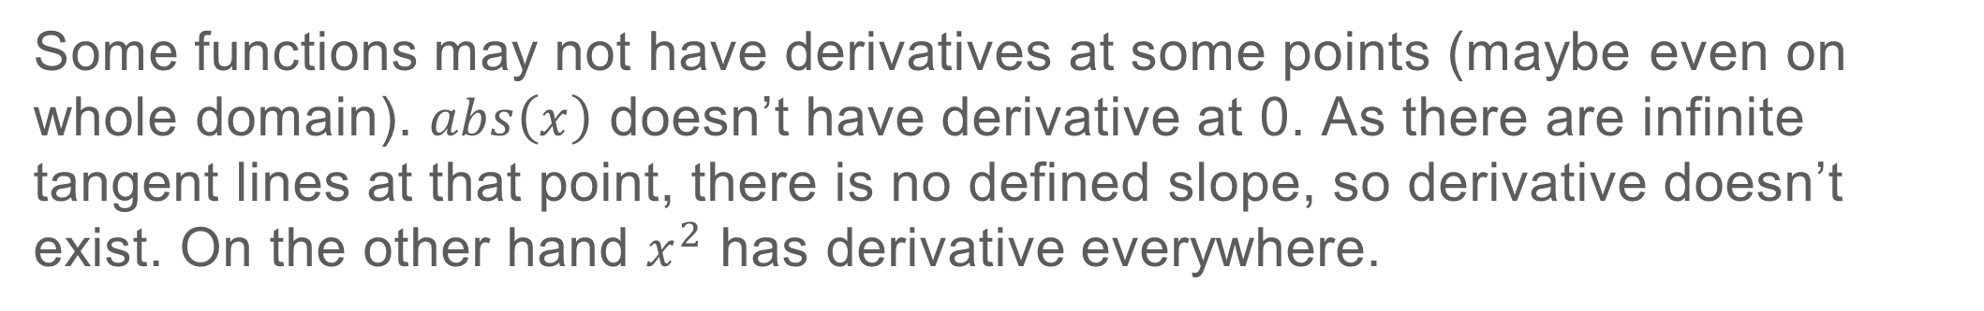
CALCULUS
Some functions may not have derivatives at some points (maybe even on whole domain). $abs\left(x\right)$ doesn’t have derivative at 0. As there are infinite tangent lines at that point, there is no defined slope, so derivative doesn’t exist. On the other hand $x^{2}$ has derivative everywhere.

Slide 11
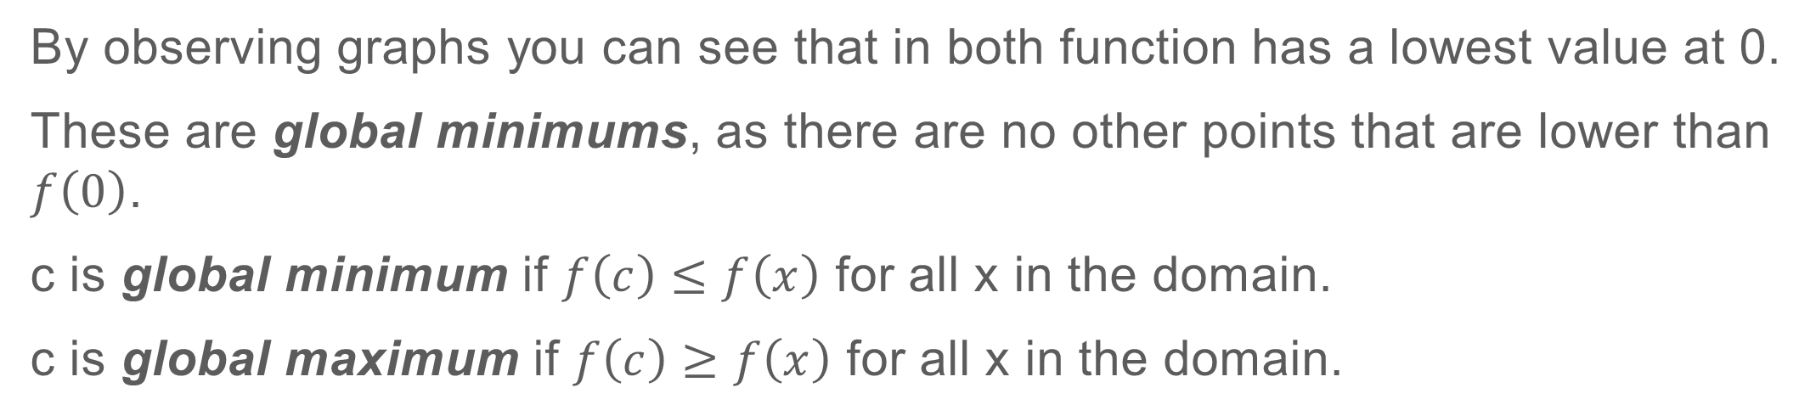
CALCULUS
By observing graphs you can see that in both function has a lowest value at 0.
These are global minimums, as there are no other points that are lower than $f\left(0\right)$.
c is global minimum if $f\left(c\right)≤f\left(x\right)$ for all x in the domain.
c is global maximum if $f\left(c\right)≥f\left(x\right)$ for all x in the domain.

Slide 12
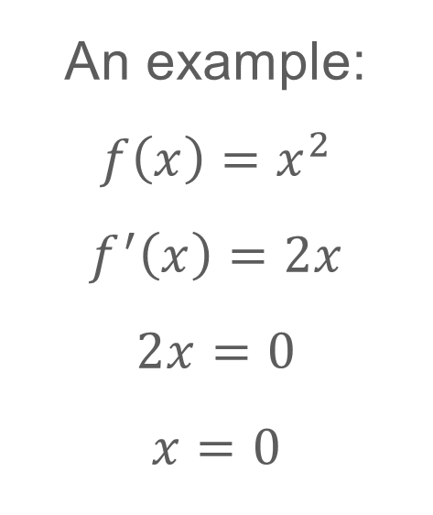
CALCULUS
In the minimum/maximum point the function derivative is either equal 0 or undefined.
An example:
$$f\left(x\right)=x^{2}$$
$$f^{′}\left(x\right)=2x$$
$$2x=0$$
$$x=0$$
There are more conditions for the derivative, check https://www.dummies.com/education/math/calculus/how-to-find-local-extrema-with-the-first-derivative-test/

Slide 13
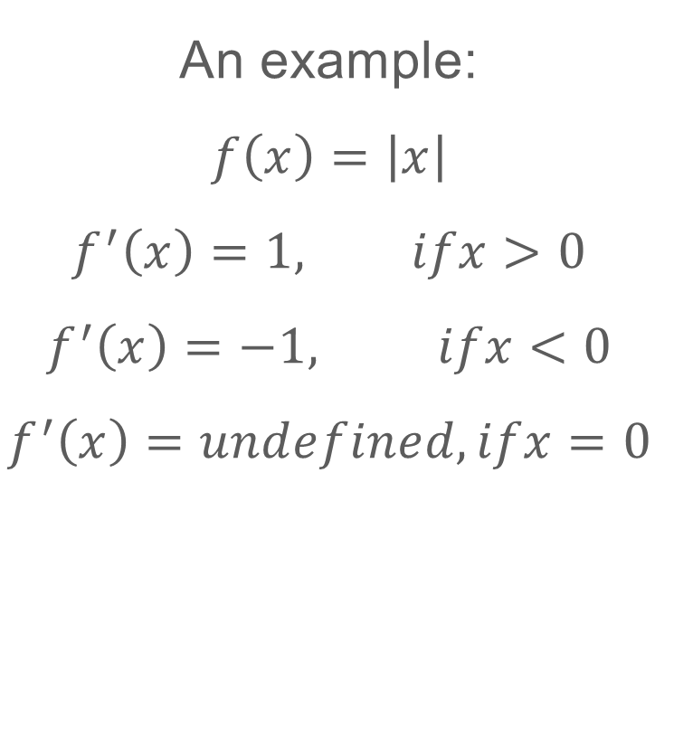

CALCULUS
In the minimum/maximum point the function derivative is either equal 0 or undefined.
An example:
$$f\left(x\right)=\left|x\right|$$
$$f^{′}\left(x\right)=1, ifx>0$$
$$f^{′}\left(x\right)=−1, ifx<0$$
$$f^{′}\left(x\right)=undefined, ifx=0$$
We can check that at any point other than 0 $\left|x\right|$ is greater than 0.

Slide 14
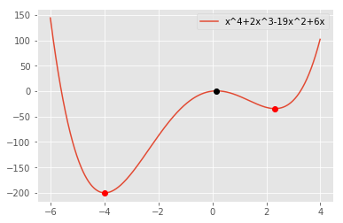
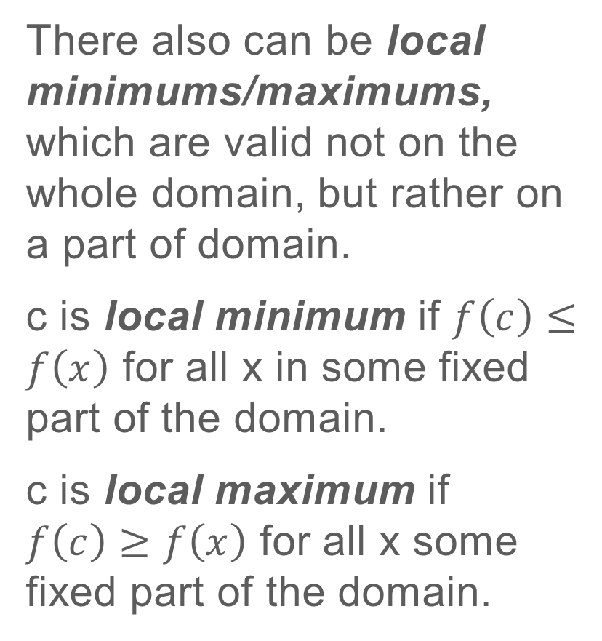
CALCULUS
There also can be local minimums/maximums, which are valid not on the whole domain, but rather on a part of domain.
c is local minimum if $f\left(c\right)≤f\left(x\right)$ for all x in some fixed part of the domain.
c is local maximum if $f\left(c\right)≥f\left(x\right)$ for all x some fixed part of the domain.

Slide 15
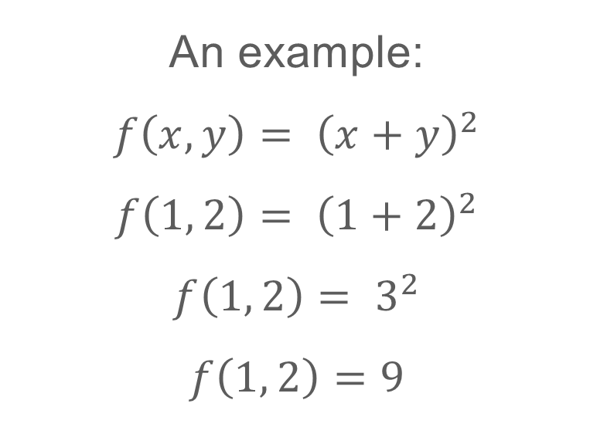

CALCULUS
Functions can have also multiple inputs.
$$f\left(x,y\right)$$
An example:
$$f\left(x,y\right)= {\left(x+y\right)}^{2}$$
$$f\left(1, 2\right)= {\left(1+2\right)}^{2}$$
$$f\left(1, 2\right)= 3^{2}$$
$$f\left(1, 2\right)=9$$

Slide 16
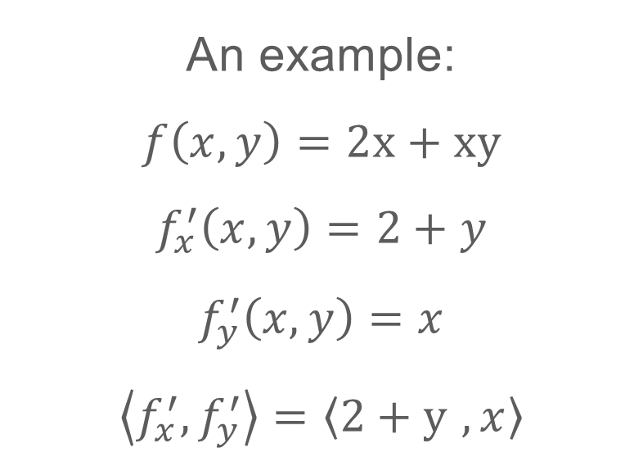
CALCULUS
Functions with multiple inputs will have partial derivatives and the combination of their partial derivatives is called gradient. When calculating partial derivatives you should treat other inputs as constants.
An example:
$$f\left(x,y\right)=2x+xy$$
$$f_{x}^{′}\left(x,y\right)=2+y$$
$$f_{y}^{′}\left(x,y\right)=x$$
$$\left\langle f_{x}^{′},f_{y}^{′}\right\rangle =\left\langle 2+y ,x\right\rangle$$

Slide 17
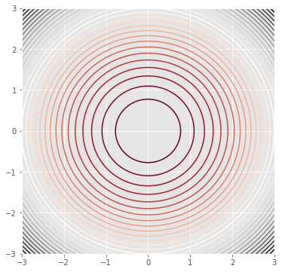
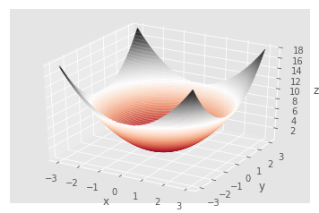
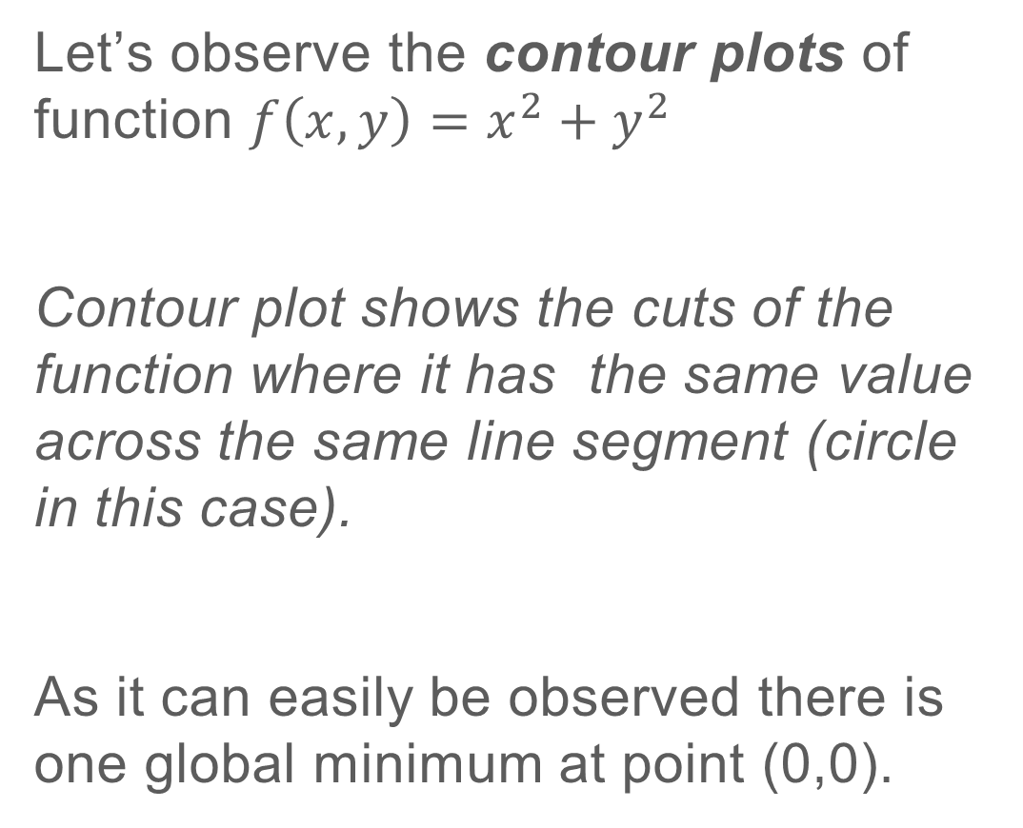
CALCULUS
Let’s observe the contour plots of function $f\left(x,y\right)=x^{2}+y^{2}$
Contour plot shows the cuts of the function where it has the same value across the same line segment (circle in this case).
As it can easily be observed there is one global minimum at point (0,0).

Slide 18
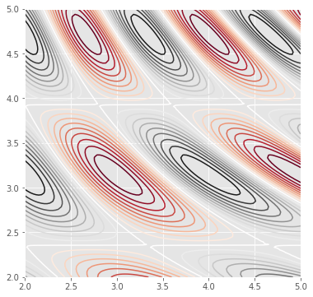
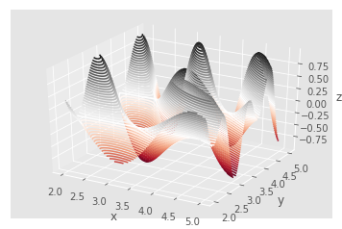
CALCULUS
Now Let’s see a contour plot of a complicated function. While advancing in machine learning these kind of plots will be beneficial in understanding how algorithms work at core.
We can see that there are many local minimums and local maximums.
Exercises on Calculus http://www.math.mcgill.ca/rags/JAC/dobson/dobson.html?fbclid=IwAR1aSkGtNJovOElpNXOGS5a9FRn0ASmtSO7iN3x1r64D3tQ2W6O1kzwcBGM

Slide 19
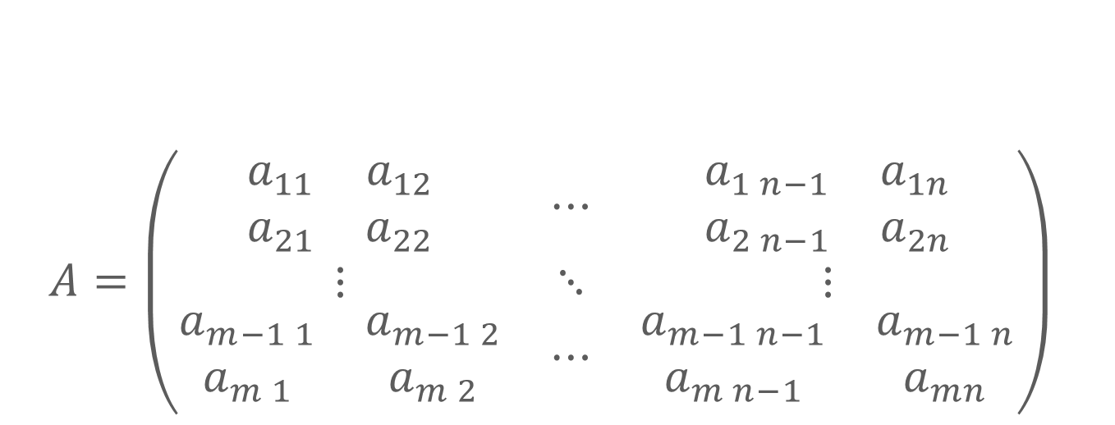
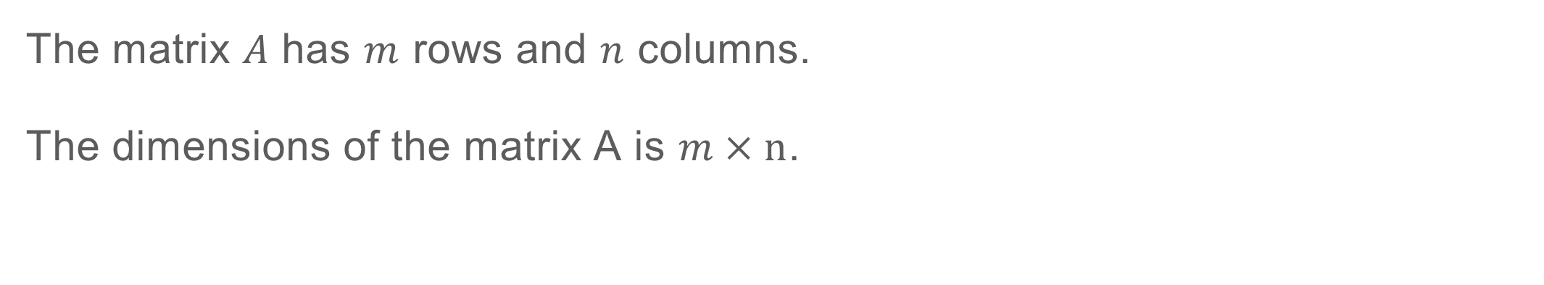
LINEAR ALGEBRA
A matrix is a collection of numbers arranged into a fixed number of rows and columns.
$$A=\left(\begin{matrix}\begin{matrix}a_{11} & a_{12} \\ a_{21} & a_{22}\end{matrix} & ⋯ & \begin{matrix}a_{1 n−1} & a_{1n} \\ a_{2 n−1} & a_{2n}\end{matrix} \\ ⋮ & ⋱ & ⋮ \\ \begin{matrix}a_{m−1 1} & a_{m−1 2} \\ a_{m 1} & a_{m 2}\end{matrix} & ⋯ & \begin{matrix}a_{m−1 n−1} & a_{m−1 n} \\ a_{m n−1} & a_{mn}\end{matrix}\end{matrix}\right)$$
The matrix $A$ has $m$ rows and $n$ columns.
The dimensions of the matrix A is $m×\text{n}$.

Slide 20
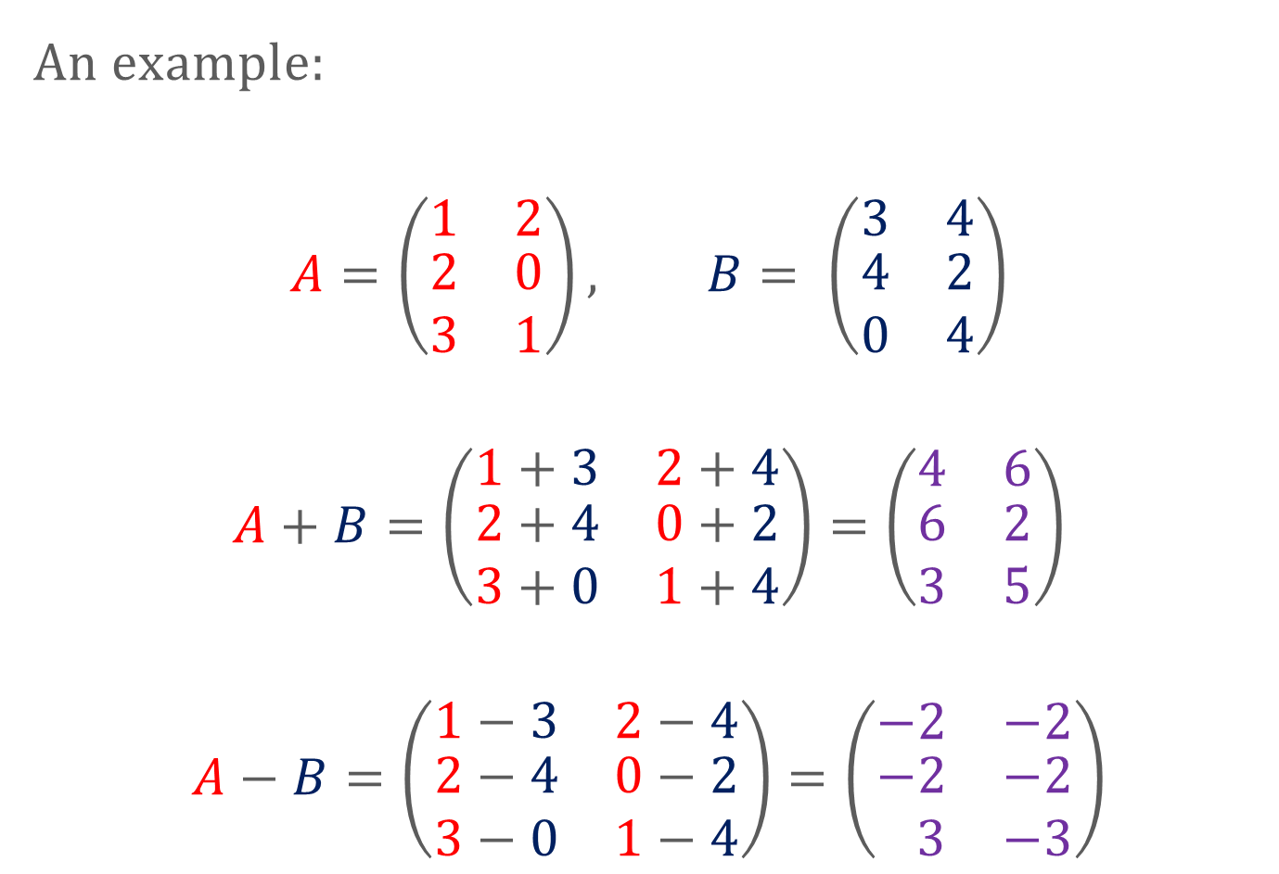
LINEAR ALGEBRA
Matrix addition and subtraction are done elementwise (there also exists elementwise multiplication but is rarely used).
An example:
$$A=\left(\begin{matrix}1 & 2 \\ \begin{matrix}2 \\ 3\end{matrix} & \begin{matrix}0 \\ 1\end{matrix}\end{matrix}\right), B= \left(\begin{matrix}3 & 4 \\ \begin{matrix}4 \\ 0\end{matrix} & \begin{matrix}2 \\ 4\end{matrix}\end{matrix}\right)$$
$$A+B=\left(\begin{matrix}1+3 & 2+4 \\ \begin{matrix}2+4 \\ 3+0\end{matrix} & \begin{matrix}0+2 \\ 1+4\end{matrix}\end{matrix}\right)=\left(\begin{matrix}4 & 6 \\ \begin{matrix}6 \\ 3\end{matrix} & \begin{matrix}2 \\ 5\end{matrix}\end{matrix}\right)$$
$$A−B=\left(\begin{matrix}1−3 & 2−4 \\ \begin{matrix}2−4 \\ 3−0\end{matrix} & \begin{matrix}0−2 \\ 1−4\end{matrix}\end{matrix}\right)=\left(\begin{matrix}−2 & −2 \\ \begin{matrix}−2 \\ 3\end{matrix} & \begin{matrix}−2 \\ −3\end{matrix}\end{matrix}\right)$$
Note: matrices should have same dimensions

Slide 21
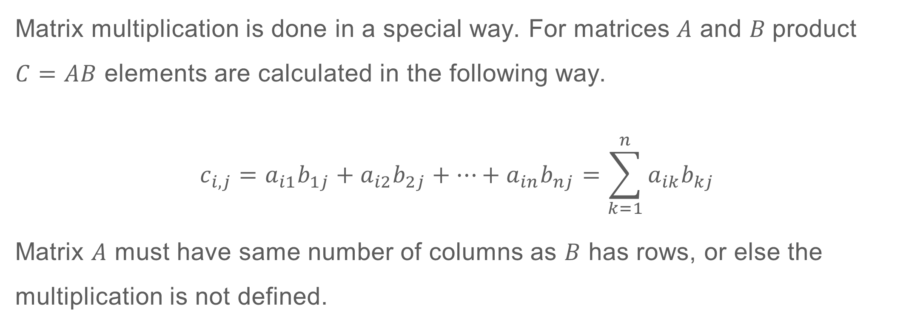
LINEAR ALGEBRA
Matrix multiplication is done in a special way. For matrices $A$ and $B$product $C=AB$ elements are calculated in the following way.
$$c_{i,j}=a_{i1}b_{1j}+a_{i2}b_{2j}+⋯+a_{in}b_{nj}=\sum_{k=1}^{n}{a_{ik}b_{kj}}$$
Matrix $A$ must have same number of columns as $B$ has rows, or else the multiplication is not defined.

Slide 22

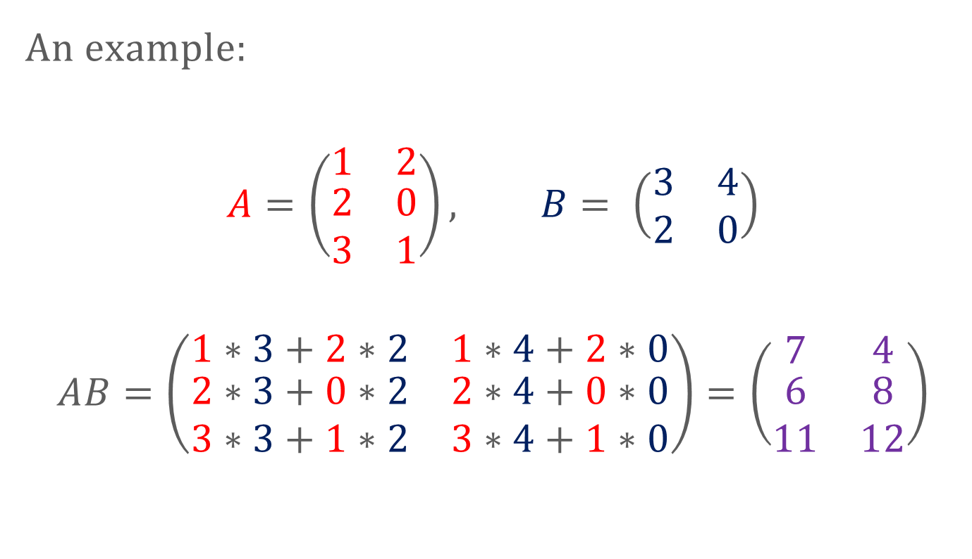
LINEAR ALGEBRA
For matrices $A\left(n×m\right)$ and $B\left(m×p\right)$ the product matrix will have dimensions $n×p$
An example:
$$A=\left(\begin{matrix}1 & 2 \\ \begin{matrix}2 \\ 3\end{matrix} & \begin{matrix}0 \\ 1\end{matrix}\end{matrix}\right), B= \left(\begin{matrix}3 & 4 \\ 2 & 0\end{matrix}\right)$$
$$AB=\left(\begin{matrix}1∗3+2∗2 & 1∗4+2∗0 \\ \begin{matrix}2∗3+0∗2 \\ 3∗3+1∗2\end{matrix} & \begin{matrix}2∗4+0∗0 \\ 3∗4+1∗0\end{matrix}\end{matrix}\right)=\left(\begin{matrix}7 & 4 \\ \begin{matrix}6 \\ 11\end{matrix} & \begin{matrix}8 \\ 12\end{matrix}\end{matrix}\right)$$

Slide 23


LINEAR ALGEBRA
The transpose of matrix $A$ is just the same matrix with flipped rows and columns.
An example:
$$A=\left(\begin{matrix}1 & 2 \\ \begin{matrix}5 \\ 3\end{matrix} & \begin{matrix}0 \\ 7\end{matrix}\end{matrix}\right), A^{T}=\left(\begin{matrix}1 & \begin{matrix}5 & 3\end{matrix} \\ 2 & \begin{matrix}0 & 7\end{matrix}\end{matrix}\right)$$

Slide 24
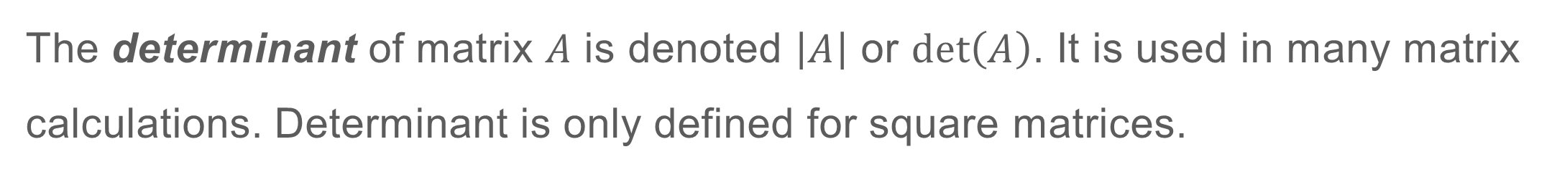
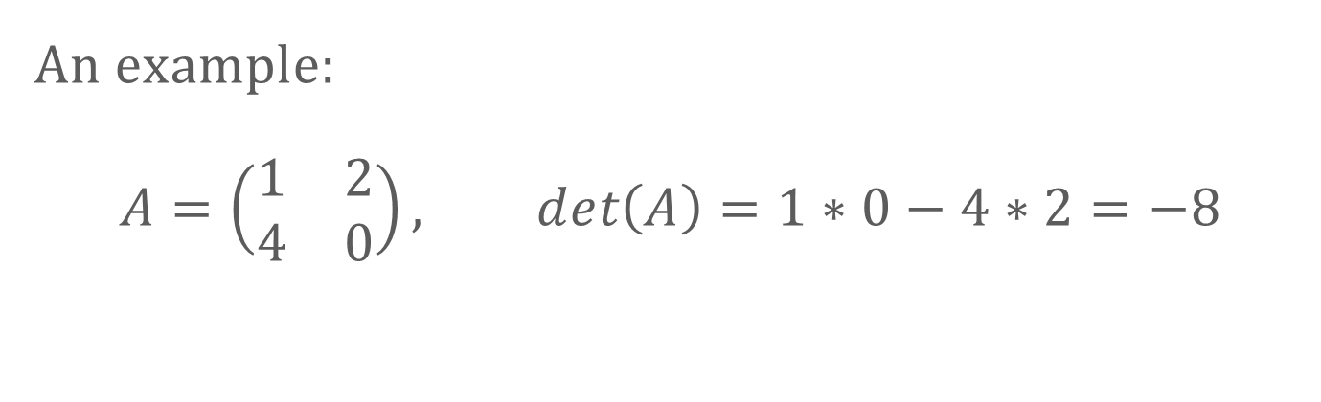
LINEAR ALGEBRA
The determinant of matrix $A$ is denoted $\left|A\right|$ or $\det\left(A\right)$. It is used in many matrix calculations. Determinant is only defined for square matrices.
An example:
$$A=\left(\begin{matrix}1 & 2 \\ 4 & 0\end{matrix}\right), det\left(A\right)=1∗0−4∗2=−8$$
Follow below links to see determinant calculations of bigger matrices https://en.wikipedia.org/wiki/Determinant https://www.mathsisfun.com/algebra/matrix-determinant.html

Slide 25

LINEAR ALGEBRA
An Identity matrix is a square matrix which diagonal is all 1s and other elements are 0.
An example: $$I_{n}=\left(\begin{matrix}\begin{matrix}1 & 0 \\ 0 & 1\end{matrix} & ⋯ & \begin{matrix}0 & 0 \\ 0 & 0\end{matrix} \\ ⋮ & ⋱ & ⋮ \\ \begin{matrix}0 & 0 \\ 0 & 0\end{matrix} & ⋯ & \begin{matrix}1 & 0 \\ 0 & 1\end{matrix}\end{matrix}\right), n×n matrix$$

Slide 26
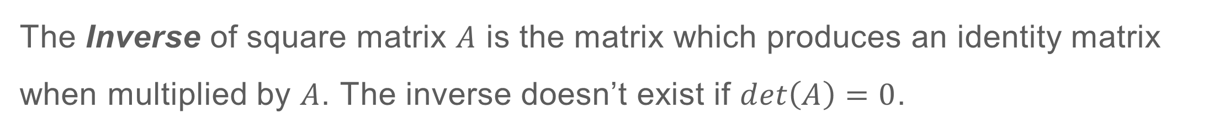
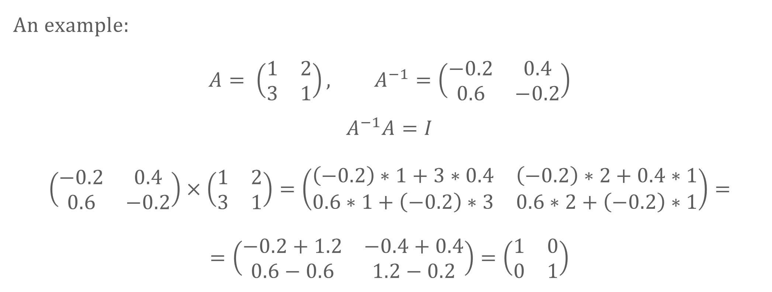
LINEAR ALGEBRA
The Inverse of square matrix $A$ is the matrix which produces an identity matrix when multiplied by $A$. The inverse doesn’t exist if $det\left(A\right)=0$.
An example: $$A= \left(\begin{matrix}1 & 2 \\ 3 & 1\end{matrix}\right), A^{−1}=\left(\begin{matrix}−0.2 & 0.4 \\ 0.6 & −0.2\end{matrix}\right)$$
$$A^{−1}A=I$$
$$\left(\begin{matrix}−0.2 & 0.4 \\ 0.6 & −0.2\end{matrix}\right)×\left(\begin{matrix}1 & 2 \\ 3 & 1\end{matrix}\right)=\left(\begin{matrix}\left(−0.2\right)∗1+3∗0.4 & \left(−0.2\right)∗2+0.4∗1 \\ 0.6∗1+\left(−0.2\right)∗3 & 0.6∗2+\left(−0.2\right)∗1\end{matrix}\right)==\left(\begin{matrix}−0.2+1.2 & −0.4+0.4 \\ 0.6−0.6 & 1.2−0.2\end{matrix}\right)=\left(\begin{matrix}1 & 0 \\ 0 & 1\end{matrix}\right)$$
To see how $A^{−1}$ is calculated follow the links below https://www.mathsisfun.com/algebra/matrix-inverse-minors-cofactors-adjugate.html https://www.mathsisfun.com/algebra/matrix-inverse-row-operations-gauss-jordan.html

Slide 27

LINEAR ALGEBRA
Some matrix manipulation rules.
$${\left(AB\right)}^{T}=B^{T}A^{T}$$
$$\left(A+B\right)C=AC+BC$$
$$AB≠BA$$
$${{AA}^{−1}=A}^{−1}A=I$$
Some more rules. http://www.gatsby.ucl.ac.uk/teaching/courses/sntn/sntn-2017/resources/Matrix_derivatives_cribsheet.pdf

Slide 28
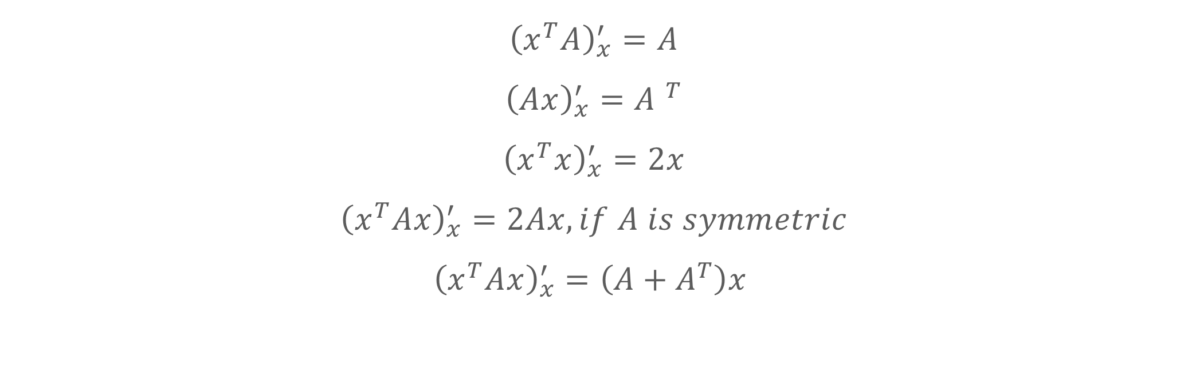
LINEAR ALGEBRA
Derivative rules with matrices.
$${\left(x^{T}A\right)}_{x}^{′}=A$$
$${\left(Ax\right)}_{x}^{′}={A }^{T}$$
$${\left(x^{T}x\right)}_{x}^{′}=2x$$
$${\left(x^{T}Ax\right)}_{x}^{′}=2Ax, if A is symmetric$$
$${\left(x^{T}Ax\right)}_{x}^{′}=\left(A+A^{T}\right)x$$

Slide 29
LINEAR ALGEBRA
Some more resources.
http://www.ee.ic.ac.uk/hp/staff/dmb/matrix/calculus.html
https://arxiv.org/pdf/1802.01528.pdf
https://atmos.washington.edu/~dennis/MatrixCalculus.pdf
https://www.math.uwaterloo.ca/~hwolkowi/matrixcookbook.pdf
https://en.wikipedia.org/wiki/Matrix_calculus

